Slide 1




http://journalmap.org
Search filtering, data entry and coordinate parsing
Jason W. Karl, Ph.D.
Jeffrey K. Gillan
Ty Montgomery
Richard Bliss
23 October 2013
@JournalMap

Slide 2
Geographic-based literature searching
Results
Theme
Place name
General context
Semantic search
Relevant to theme
Relevant by similar ecological context
Relevant to location
Question: e.g., soil erosion in North American Southwest
Specific location
Ecologically similar areas
Geo-semantic search

Slide 3
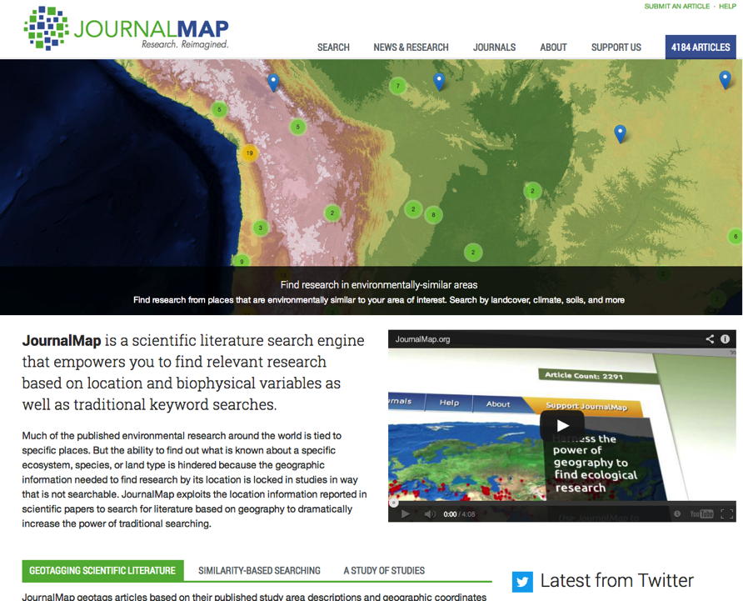

Slide 4
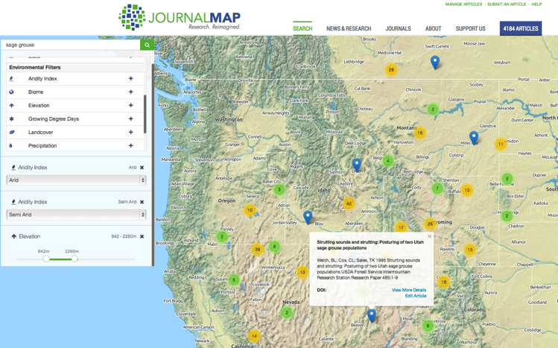
Searching/Filtering Articles in JournalMap
Key word/term searching
Filters for different environmental, location, and citation attributes are available for querying JournalMap in addition to key words/terms.
Categorical filters are additive (i.e., aridity index of arid OR semi-arid)
Continuous variable filtering set by a slider.
Basic citation information and a link to the article in the popup bubble.

Slide 5
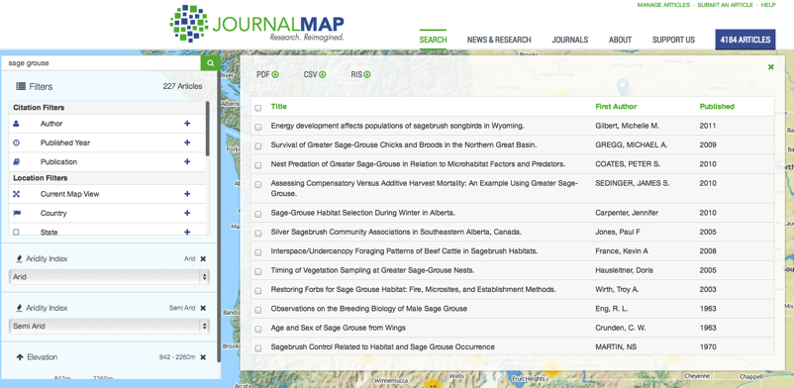
JournalMap search result exporting
Search results can be viewed as a list and exported from JournalMap in several formats.
Spatial download formats (e.g., shapefile, KML) coming soon.

Slide 6
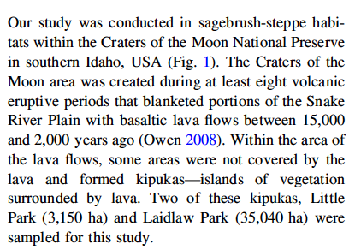
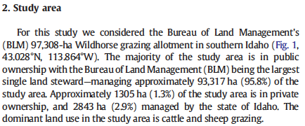
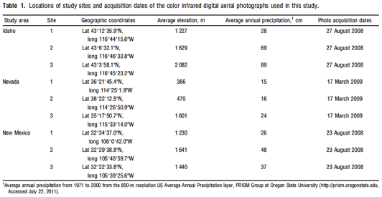
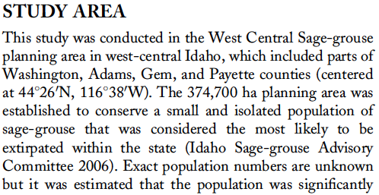
Challenge: Extracting location information from published studies
Notes:
The challenge in populating a geographic database of published studies comes from the myriad formats for reporting location. Locations can be reported as place names, or via coordinates. Even with coordinates, there are countless different ways to represent or format those values. Also, locations may be reported in the body text or in tables, figures, or appendices.
Note that all the examples above come from papers that I have authored – so I’m just as much to blame as anybody else!

Slide 7
Location Reporting in Studies
Place Name Reported (32%)
Geographic Coordinate System (90%)
Coordinates Reported (58%)
Other Coordinate System (10%)
No Location (10%)
Notes:
In scientific literature on natural resources, the majority of studies report some kind of location where the study was conducted. Those papers that don’t report a location are generally review papers, syntheses, opinions, or conceptual papers. Of the studies reporting a location, about 60% use some kind of coordinate in that study area description. Of the coordinates reported, about 90% are some format of a geographic coordinate system (i.e., degrees, minutes, seconds).
These stats are taken from the sample of over 5000 articles that have been reviewed for JournalMap.

Slide 8
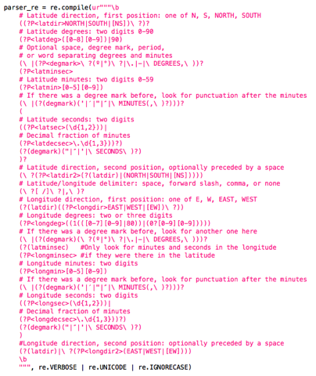
Parsing coordinates from text
Need automated way to recognize and extract coordinates from text
Convert coordinate information into common form
Regular expressions
Python or Ruby
Text “clips” or full text articles
JournalMap web form
HTML pages
XML document batching
Notes:
We can recognize, extract, and standardize coordinates reported in articles using a set of Regular Expressions. In JournalMap, this is accomplished by parsing snippets of text the user has identified as containing a coordinate (for single-article entry form) or by parsing entire XML documents (via batch data upload). Additionally, we have the ability to parse entire HTML documents in an automated fashion for geographic coordinates.
At this point we do not have the ability to parse PDF files due to issues with character encoding and font embedding in the PDF files. This is a priority for future JournalMap development.

Slide 9
Coordinate parser examples
N424400 W800557
-31.96 115.84
5335N / 12155W
32.30642° N 122.61458° W
49-21.834N 126-15.923W
41.25 degrees, -120.9762 degrees
5033.15N 11544.09W
52 North 50 West
502661N 1214161W
58147N/07720W
484819N 1231195W
(45º10'17"N 076º23'46"W)
(45º10"17'N 076º23"46'W)
(40º02.247'N 111º44.383'W)
N52:57:40, E0:46:04
70 ° 57N 070 ° 05W
(N51.33.9 W119.02.30)
52 degrees, 42 minutes north, 124 degrees, 50 minutes west
5115N8940W
4523N/07319W
N50.26.008 W121.41.470
4630 NORTH 5705 WEST
(OSES, 39°02'N, 109°21'E)
16°30’ S, 145° 27’ E
19°09′ S–48°23′ W
Lat 43º6'32.1"N, long 116º46'33.8"W
43º01N 081º46W
52 15 10N, 0 01 54W
6535.26N/08801.25W
(4952.013N / 09548.474W)
6146 north 5328 west
(30° 47' N, 34° 46' E)
N 5930 W 12330
32.7434˚ -106.6055˚
N53 35.48 W112 02.60
(106°20' E, 38°45' N)
44°50′05″ N, 15°33′43″ E
462716N/0721147W
N495342 / W0742553
26º 26' N, 101º 6' W
50 27 55 N 127 27 65 W
52 35 31N, 1 28 05E
N4909.44 W12210.13
5734.8 N / 10006.2 W
4745N/6440W
9°21’ N, 82°15’W
33°01′34″ S; 64°11′21″ W
49º41'34"N 093º37'54"W
43º55'N 078º18'W
(16°03′ N, 16°29′ W)
5046.6N / 06829.2W
lat 26º 26' N, lon 101º 6' W
491500N 1230720W
Notes:
The 53 coordinate examples above represent the current test set that our parser can successfully recognize and standardize. All of these examples were taken from published studies, which shows the diversity and lack of standards for location reporting. The parser undoubtedly picks up more format variations that what is listed here.
Developing the parser has become an exercise in optimization. Setting it too specific in terms of formatting results in legitimate coordinates being missed (omissions). Alternatively, increasing the flexibility of the parser can result in “false positives” (commissions) where non-locational text is interpreted as a location.

Slide 10
Modes of content entry for JournalMap
Mode | Automated | Semi-automated | Manual
Single article entry via submission form | Citation (from DOI) Filtering attributes from location (e.g., elevation) | Location via coordinate or simple place name | Abstract/keywords* Location via complex/unusual place name Location quality metadata
Batch upload of XML files | Citation Abstract/keywords Locations via coordinates Some location quality metadata | Location via simple place names Review/verification of automated locations | Location via complex/unusual place name Remaining location quality metadata
“Offline” creation (via spreadsheet) and CSV upload | Depends on source of records – can be entirely automated or completely manual process. Structuring of CSV files generally semi-automated process.

Slide 11
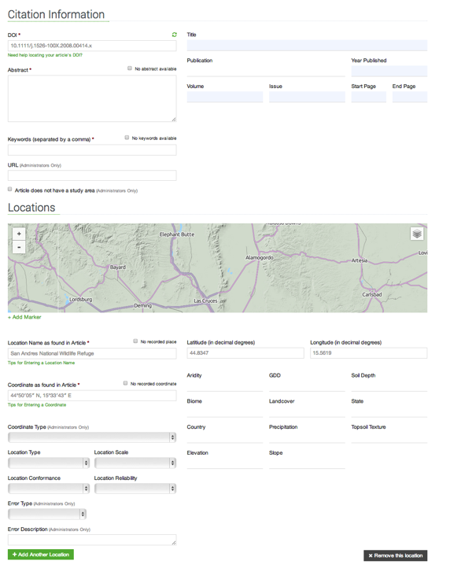
Citation information is captured automatically from the DOI number via crossref.org
Presently most abstracts/keywords need to be manually input (copy/paste). JournalMap can auto-populate these fields through Mendeley.com if articles are present, but we are looking for additional sources to do this automatically.
URL can be used as primary key field if no DOI is available
Study location can also be manually mapped by placing a marker on the map.
JournalMap Single Article Submission Form
Study area description as reported in the article is copied into this field. JournalMap supports basic place-name recognition and mapping for this field (improvements in development).
Coordinate values as reported in the study copied here. JournalMap parses this field to determine latitude/longitude values.
Location quality metadata fields.
Query/filter field values are automatically determined for each article based on its mapped locations.
Additional locations for an article can be added.
Notes:
JournalMap form for single article entry annotated to highlight different aspects of content entry.

Slide 12
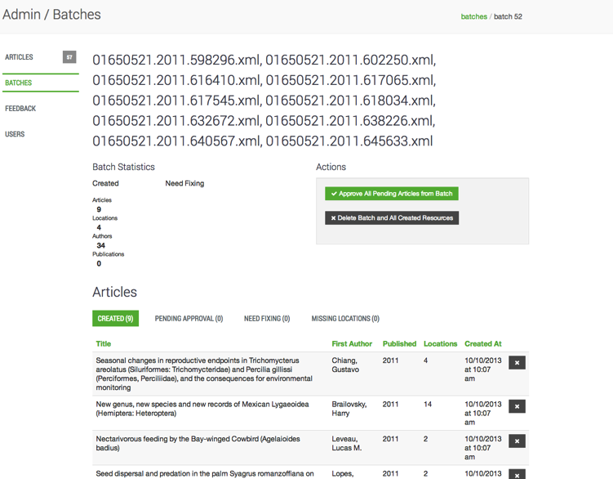
JournalMap batch data entry
Notes:
Articles can be batch uploaded into JournalMap via the admin interface. Currently we can batch upload CSV (multiple articles per CSV file) and XML formats (single article per XML, but batch multiple XML files at once).

